Slide 1

HUDAG x Roche
Final Presentation
4/29

Slide 2
Agenda
BACKGROUND
Brief overview of goals and motivations behind the project
SUMMARY OF WORK
A high-level overview of all the work accomplished
PHYSICAL MODEL WALKTHROUGH
An Rshiny app for survey collection, streamlined analyses, and automatic insights generation
FUTURE DIRECTIONS
Possible next steps and discussion

Slide 3
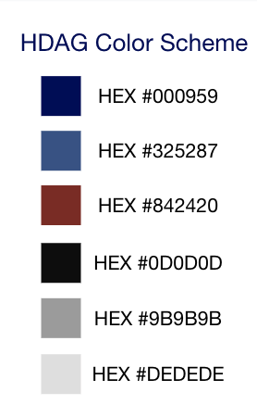
Communicate the scope and general strategies that we will implement to address/tackle the goal.
Goals and Motivation
Conceptual Model
Prior evidence suggests that an immersive experience increases empathy and understanding of a patient’s experience during illness.
Studies have also shown a positive correlation between patient experience and patient outcome, warranting an exploration into how empathy can improve patient experience through improved study design.
Our goal is to provide support for Roche’s “Through your eyes” initiative using insights from existing literature, with a particular focus on BRCA.
Three model structure...
Detail and clarification of the conceptual model. What and how can everything be measured (define metrics).
Logical Model
Full specification of data collection and analysis pipeline (technical implementation).
Physical Model

Slide 4




The case is organized around 3 causal links:
Immersion
Empathy
Study Design
Patient Experience
Can we increase the empathy of clinical trial study designers via immersion, and what types of immersion have been shown to be most impactful?
Do more empathetic researchers design more accommodating study designs?
Does increased study designer empathy lead to improved patient experience via improved study design?

Slide 5
Summary of Work Accomplished
LITERATURE REVIEW
LOGICAL MODEL
We conducted a detailed literature review across relevant industries and reported actionable insights and recommendations for next steps. We summarized our findings in a brief synopsis and compiled our paper-by-paper summaries.
Building on our conceptual model, we developed a detailed logical model comprised of a patient experience survey, study designer empathy survey, and study designer accommodation survey. Metrics for quantification were developed.
Wk 5-6
Wk 9-10
CONCEPTUAL MODEL
PHYSICAL MODEL
Wk 1-4
We developed a conceptual framework for establishing causal relationships between immersion, study designer empathy, and patient experience, leveraging previously reported study designs and novel ideas generated internally.
Wk 7-8
An Rshiny app was developed for survey collection and automatic data analyses. This allows for streamlined results generation once survey data is collected. Data was strategically simulated for demonstration purposes.

Slide 6
Literature Review
We spent the first several weeks conducting an in-depth review of the literature in the following key areas:
Patient experience in clinical trials: How are things like patient experience and patient burden measured, and can we develop an aggregate metric to quantify this?
VR use across several industries: Where has VR been already used, and has it been shown to be effective? What are relevant insights?
Study designer empathy measurement: How is empathy measured, and has VR/immersion been shown to increase empathy?
We focused primarily on breast cancer (BRCA) trials and study designs which had similar goals/motivations to ours. Literature which was directly related to each of the three causal links was particularly important.
Key deliverables...
Literature synopsis: We summarize key insights and provide actionable recommendations and next steps based on our literature review. This synopsis was continually updated and adapted to new literature.
Immersion and empathy: We specifically detail the different types of immersion strategies leveraged across several studies. The effect of different types of immersion on overall empathy is reported.
Paper-by-paper notes: Our notes on each of the papers we read are compiled in a spreadsheet, organized by the different literature review topics. Summaries, relevant insights, and data accessibility are reported for each read.

Slide 7
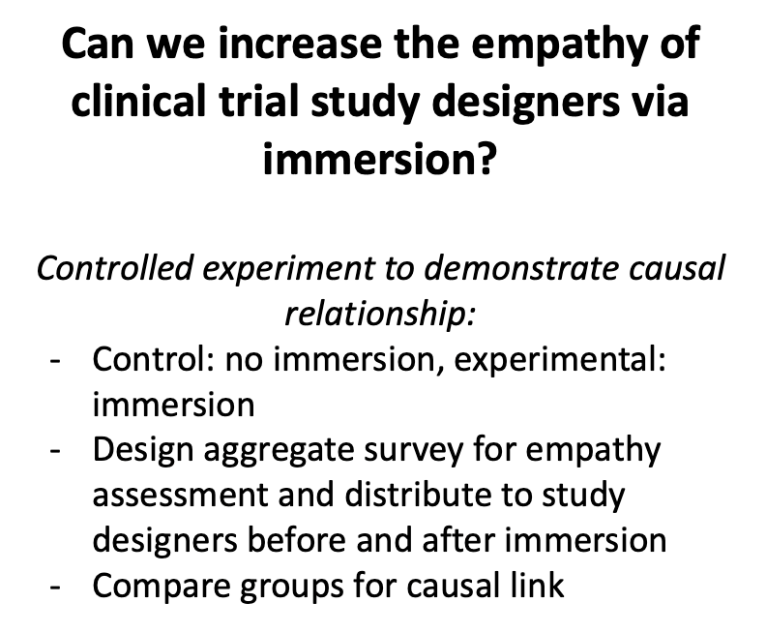
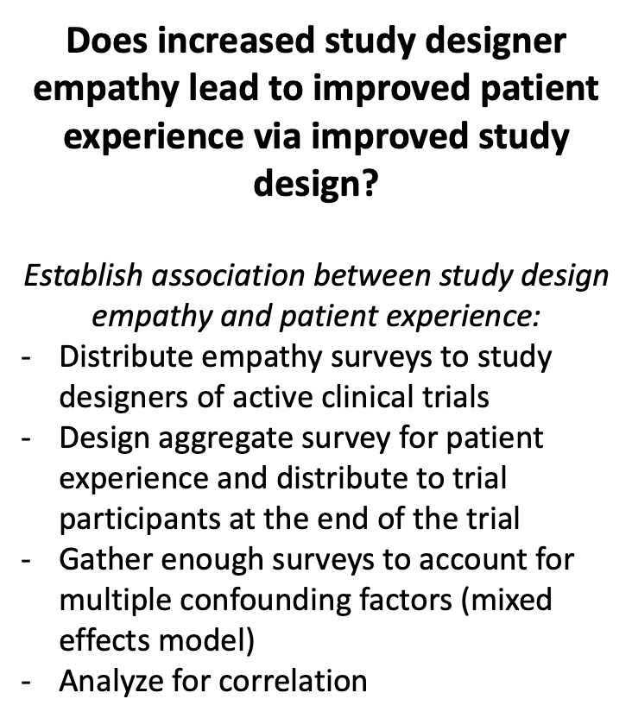
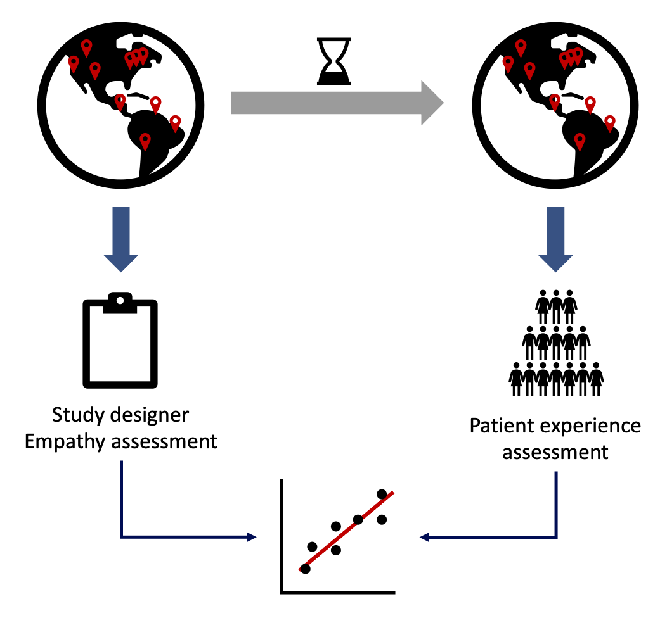
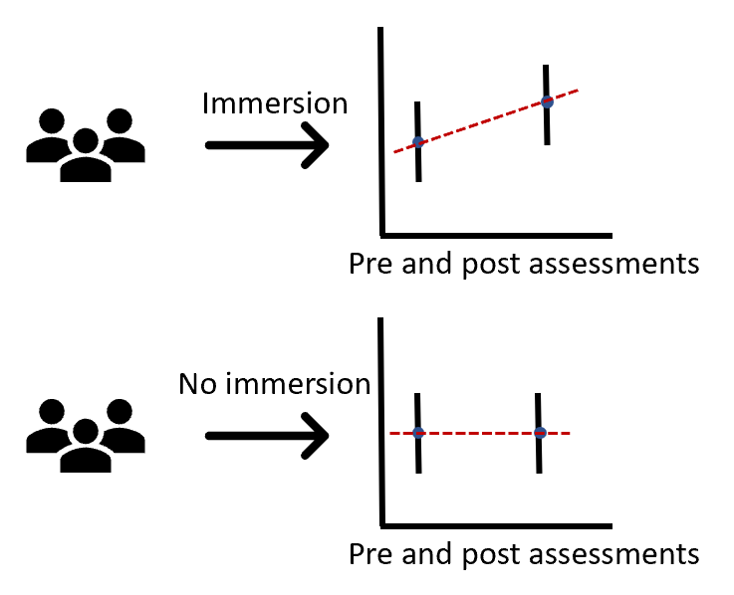
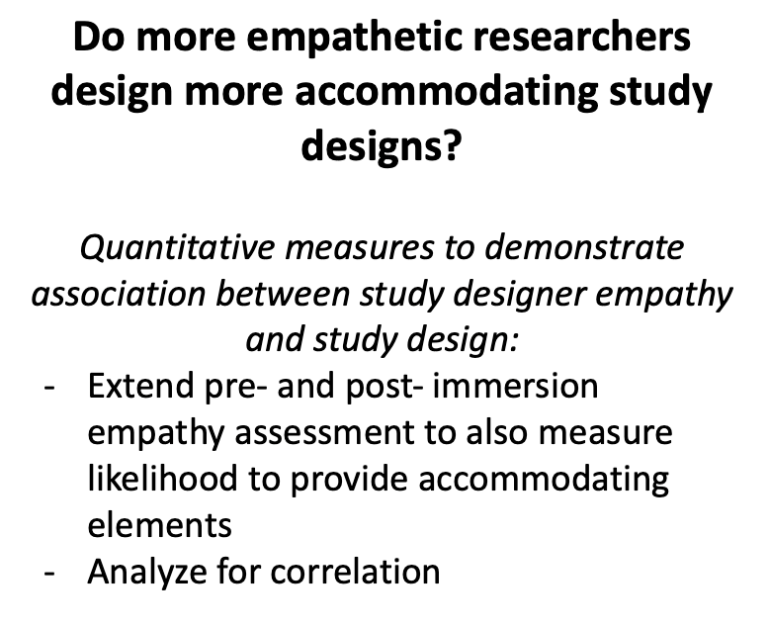
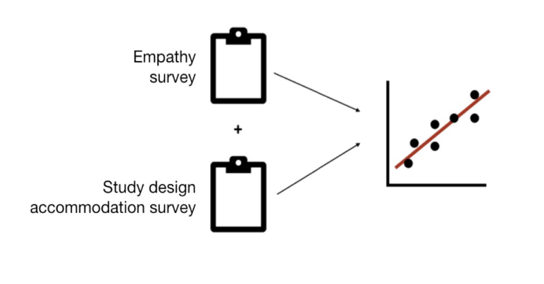
Conceptual Model
Based on insights collected from literature, we proposed a conceptual model for addressing each of the three motivational causal links.
Immersion <> Empathy:
Study Design <> Patient Experience:
Empathy <> Study Design:

Slide 8
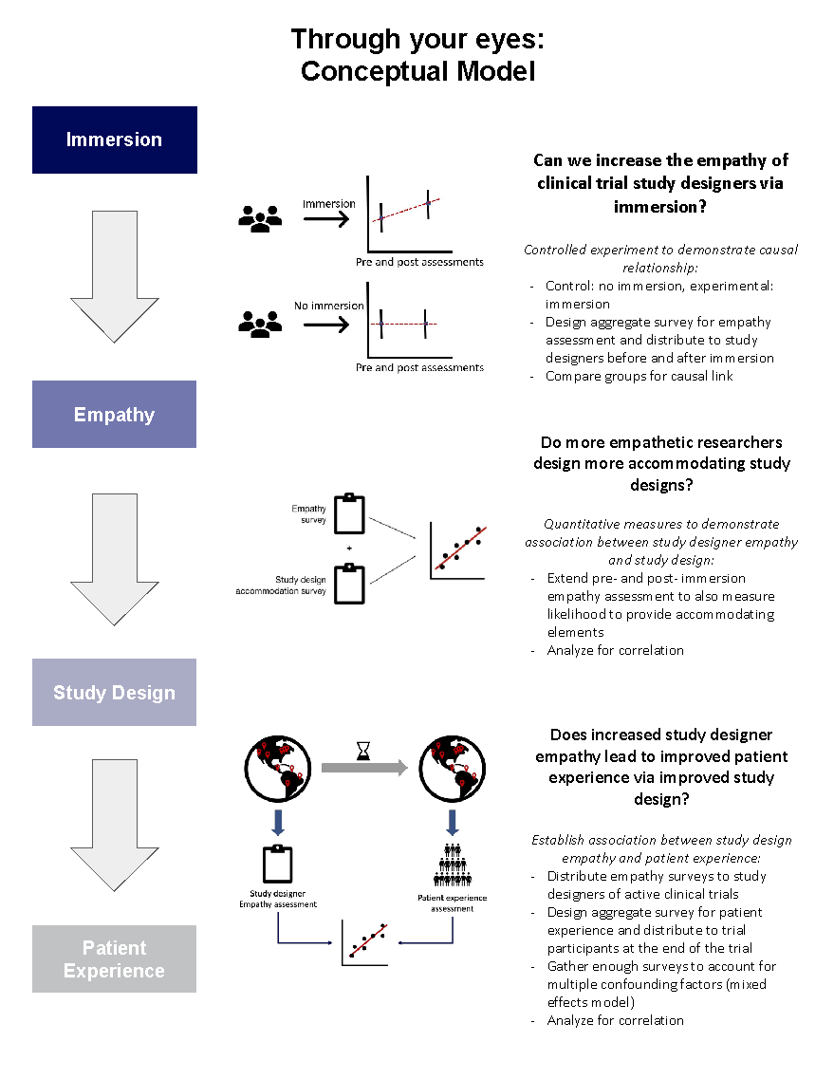
Conceptual Model
Based on insights collected from literature, we proposed a conceptual model for addressing each of the three motivational causal links.
Key deliverables...
Conceptual model report: We summarize our conceptual model structure and offer recommendations for implementation while considering challenges and costs that may be associated.
Model overview: A high-level summary of our conceptual model proposal with brief descriptions is provided for reference.

Slide 9
Logical Model
Building on our conceptual model, we developed a detailed logical model comprised of 3 main surveys
Study designer empathy survey
Goal: to quantify the empathy of a study designer toward a study participant
This survey was modeled after the Jefferson Scale of Empathy (JSE) and the Toronto Empathy Questionnaire (TEQ), two standard, reputable surveys widely used. Some questions were removed while others were modified to make more suitable for our specific applications.
Patient experience survey
Goal: to qualitatively assess and quantify the patients’ experience throughout the clinical trial
This survey was based off the CAHPS surveys; some questions were modified to make more suitable for our specific applications, and additional questions were added to address patient burden.
Seven categories of questions: demographic (10), care satisfaction (4), medical advice (4), communication (5), subjective overall rating (1), appointment timeliness (3), and visiting logistics (4). Patient-specific scores were derived for each category and subsequently aggregated.
Study designer accommodation survey
Goal: to assess study designer accommodability and contract study designer perspective with patient perspective
Questions are matched to specific questions from the patient experience survey, allowing for a comparison of study designer views with that of the patient. Potential differences between study designer and patient perspective may worsen patient experience; this highlights certain elements of study design which detract from patient satisfaction.

Slide 10
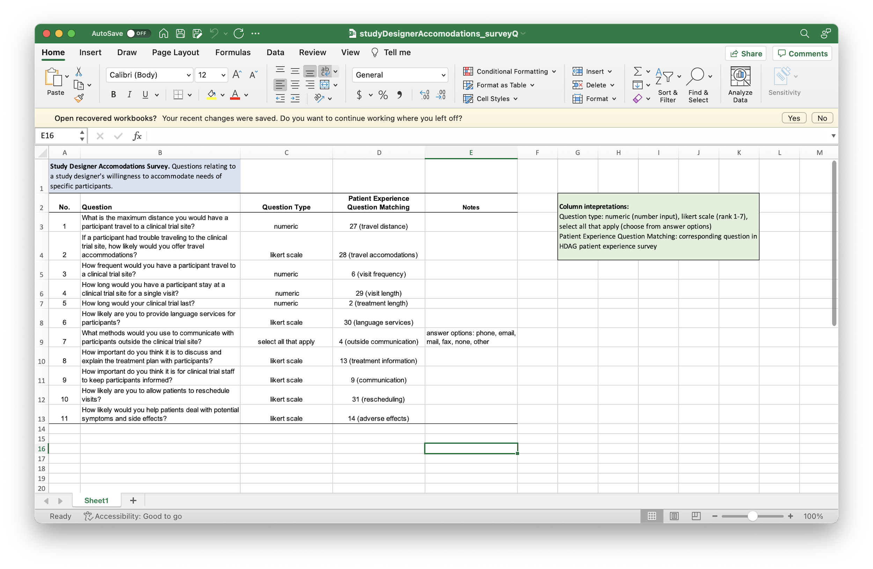
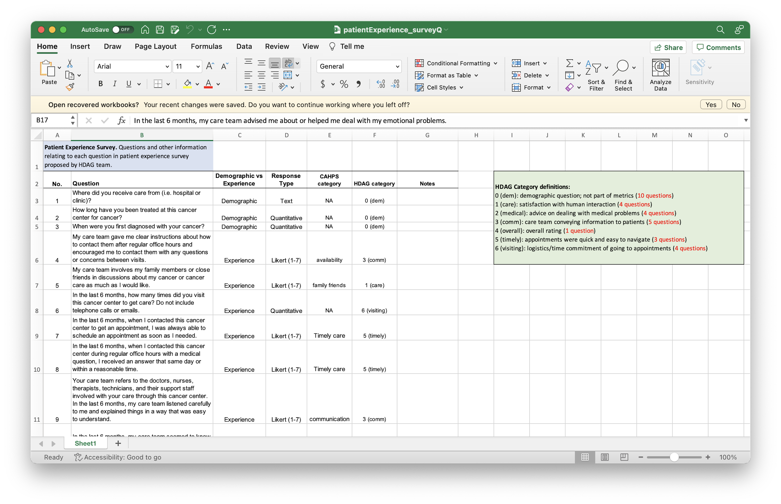
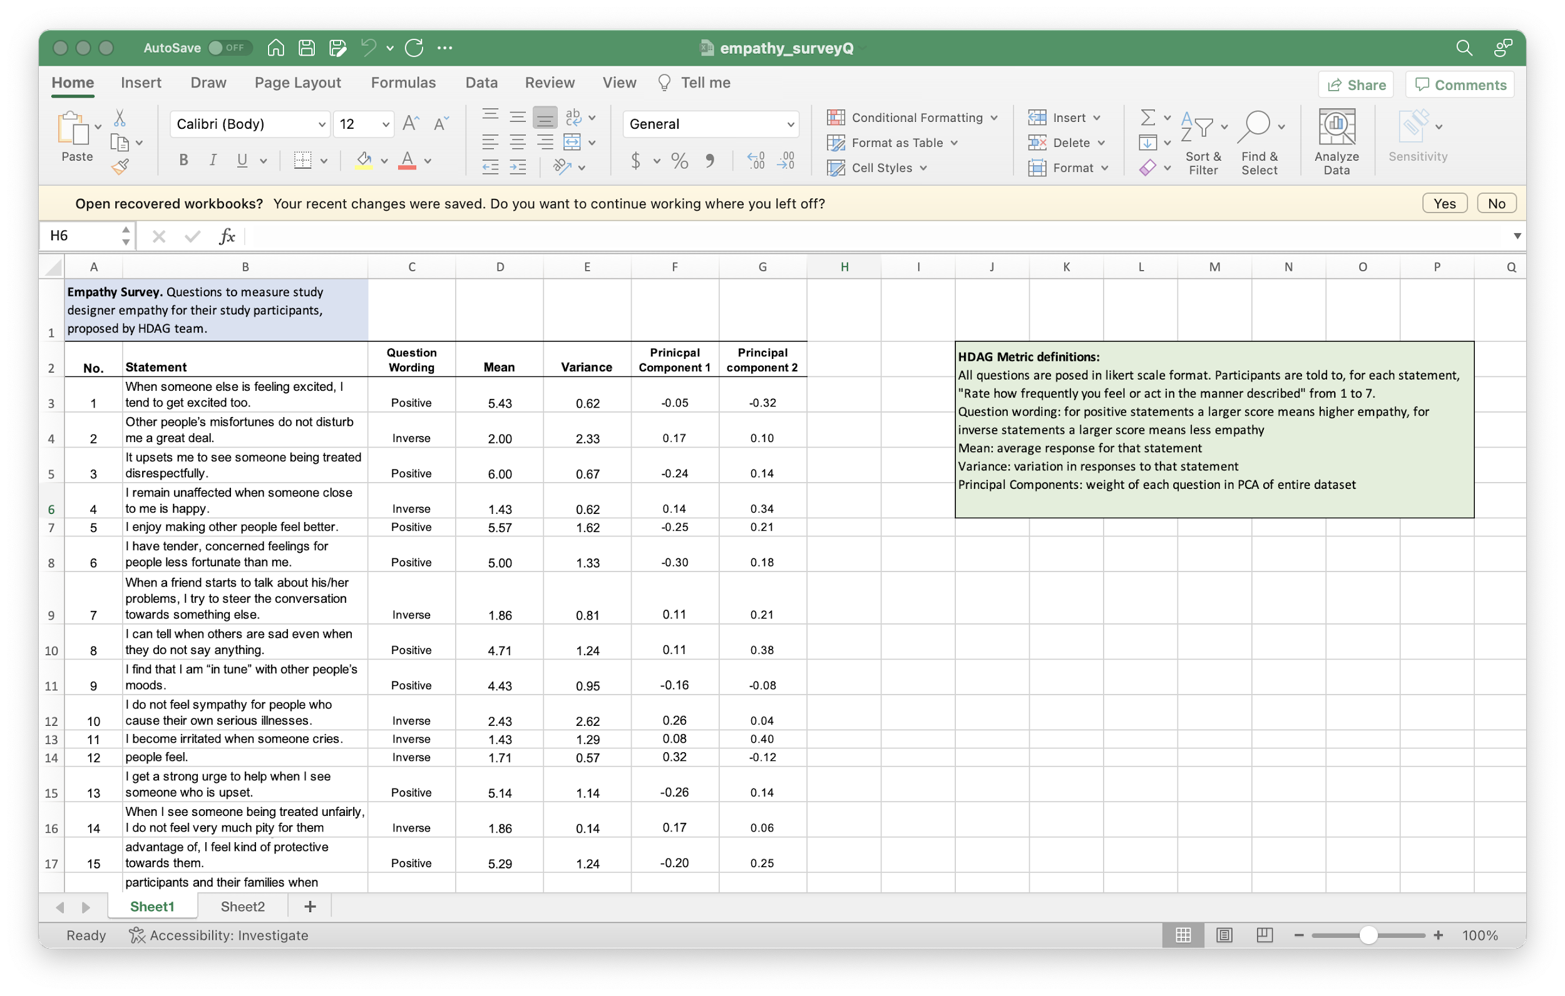
Logical Model
Building on our conceptual model, we developed a detailed logical model comprised of 3 main surveys
All surveys have been carefully curated and reviewed to remove redundancy, maintain generality, and use similar wording and style to reputable surveys from the literature.
Responses were used to derive respondent-specific scores for each survey (more details in later slides).
Question types include Likert-type questions (1-7 scale), numeric questions, dates, and category selection.
Survey manuals were developed for each survey to clarify question-specific features such as sub-category (patient experience survey) and question importance ranking (study designer empathy survey).

Slide 11
Data Simulation
Data were strategically simulated for each survey to allow for analyses/visuals development while awaiting survey data collection.
Study designer empathy survey
Internally, each HDAG team member took the empathy survey (7 respondents). We then constructed a vector of response means and a covariance matrix.
Responses were then sampled from a multivariate normal distribution parametrized by the mean vector and covariance matrix calculated from our internal survey responses.
Simulated data is then rounded and bounded to arrive at the same 1-7 Likert scale.
Patient Experience survey
Data is randomly generated here since it is more difficult to imagine the patient experience.
Data are simulated according to each type of question (numeric, likert, quantitative, binary, selection).
Study Designer Accommodation survey
Data is also randomly generated here for simplicity, again being mindful of each question’s type (numeric, likert, quantitative).
1,000 responses were simulated for each of the 3 surveys, but this is a flexible parameter.

Slide 12
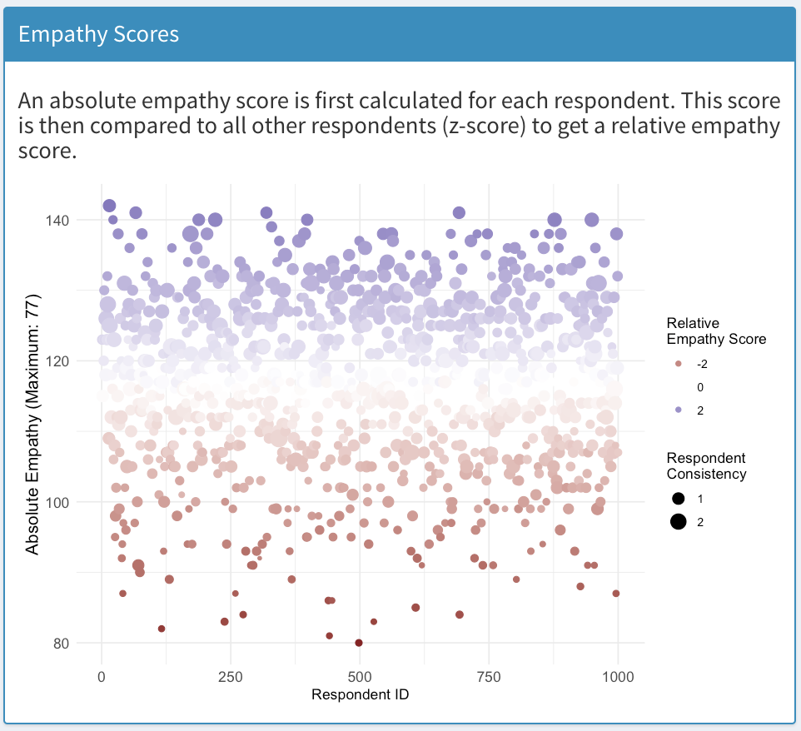
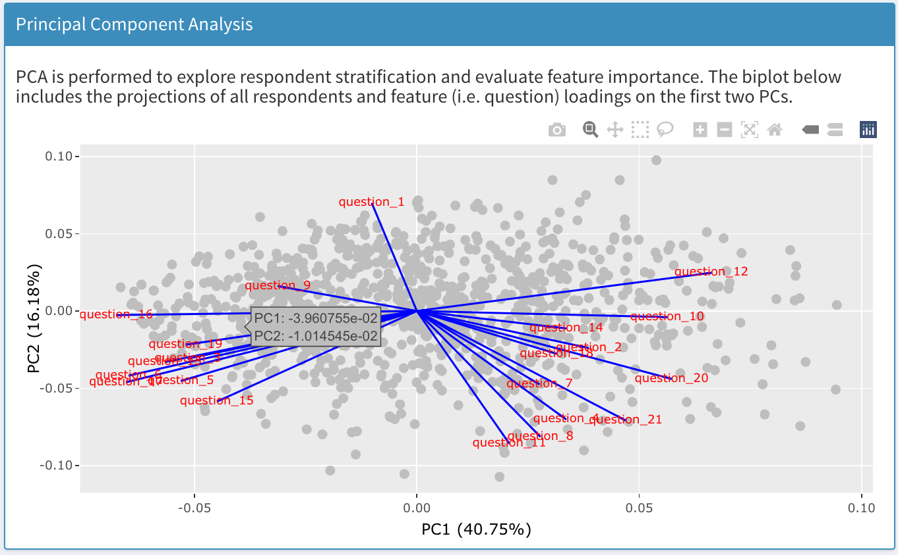
Study Designer Empathy Survey
TEQ scoring: “Scoring: Item responses are scored according to the following scale for positively worded Items 1, 3, 5, 6, 8, 9, 13, 16. Never = 0; Rarely = 1; Sometimes = 2; Often = 3; Always = 4. The following negatively worded items are reverse scored: 2, 4, 7, 10, 11, 12, 14, 15. Scores are summed to derive total for the Toronto Empathy Questionnaire, which can range from 0 to 64...”
We have 21 questions (10 negatively worded, 11 positively worded). We define three main scoring metrics...
Absolute empathy: reverse score negatively worded questions and sum across all questions (21*7 = 147 max possible score).
Relative empathy: calculate z-score within question for each respondent. Calculate mean across positive questions and subtract mean across negative questions.
Consistency: inverse of (variance across positively worded questions + variance across negatively worded questions).
Further, internally, each of the HDAG analysts took the empathy survey (7 respondents). Questions were ranked based on variance and PC loading, allowing for thresholding based on allocated costs.

Slide 13
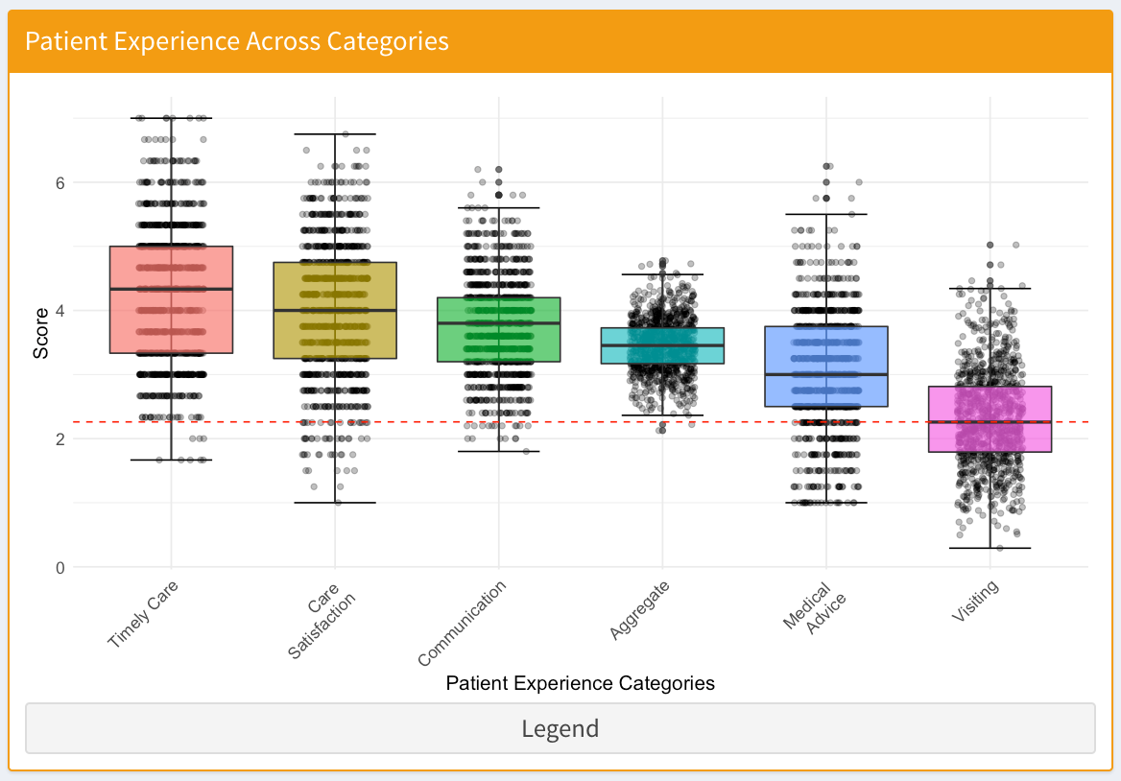
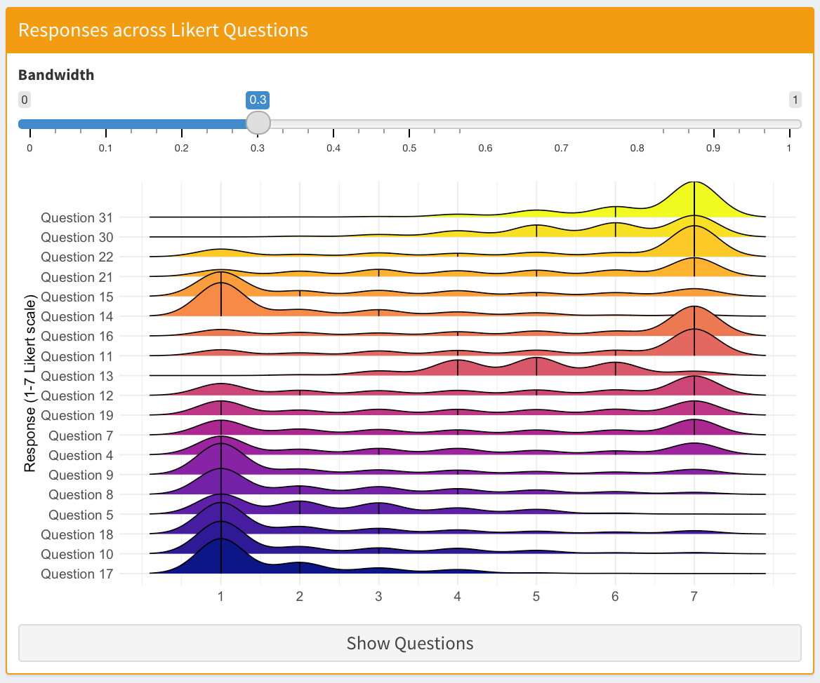
Patient Experience Survey
Seven categories of questions: demographic (10), care satisfaction (4), medical advice (4), communication (5), subjective overall rating (1), appointment timeliness (3), and visiting logistics (4).
Patient-specific scores were derived for each category. Likert-type questions were averaged (no negatively worded questions here). Numeric questions (i.e. travel distance to trial site) were scaled to the same 1-7 and averaged.
All categories were subsequently aggregated, weighted by the fraction of questions in the patient experience assigned to that category.

Slide 14
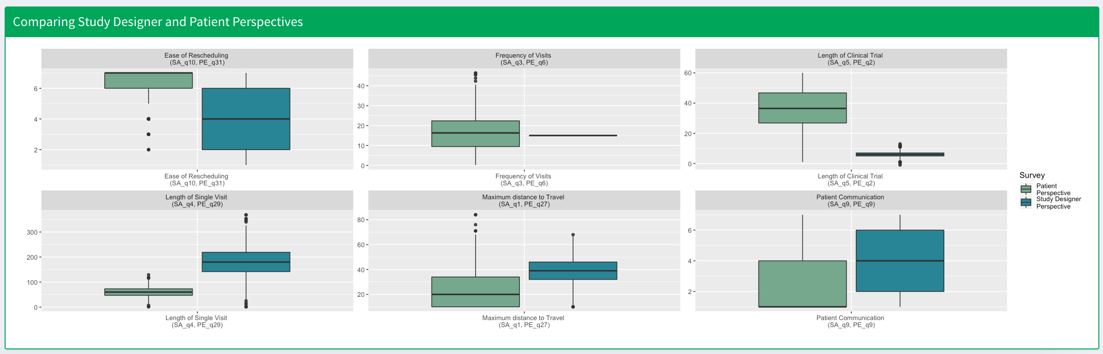
Study Designer Accommodation Survey
Study designer accommodation questions all have a matched question from the patient experience survey. This allows for a comparison of study designer perspective with that of the patient (e.g. length of visit).
Potential differences between study designer understanding and patient perspective may be responsible for a worse patient experience. Thus, we can highlight certain elements of study design which detract from patient satisfaction as a call-to-action for the IPEX initiative.

Slide 15

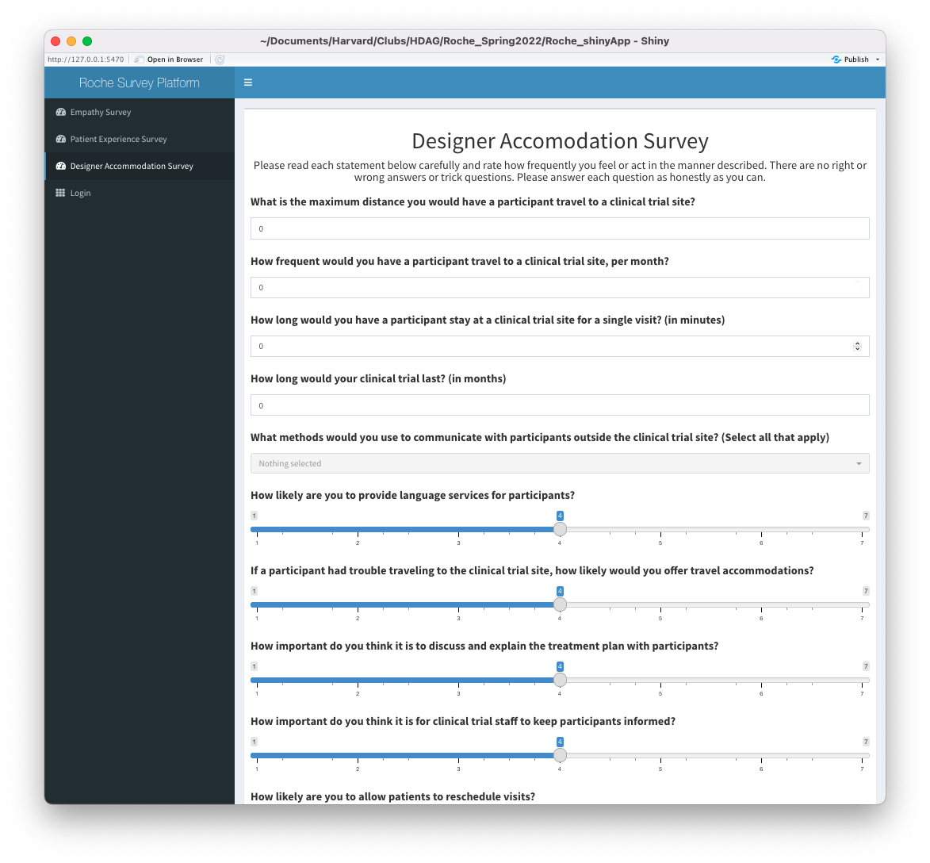
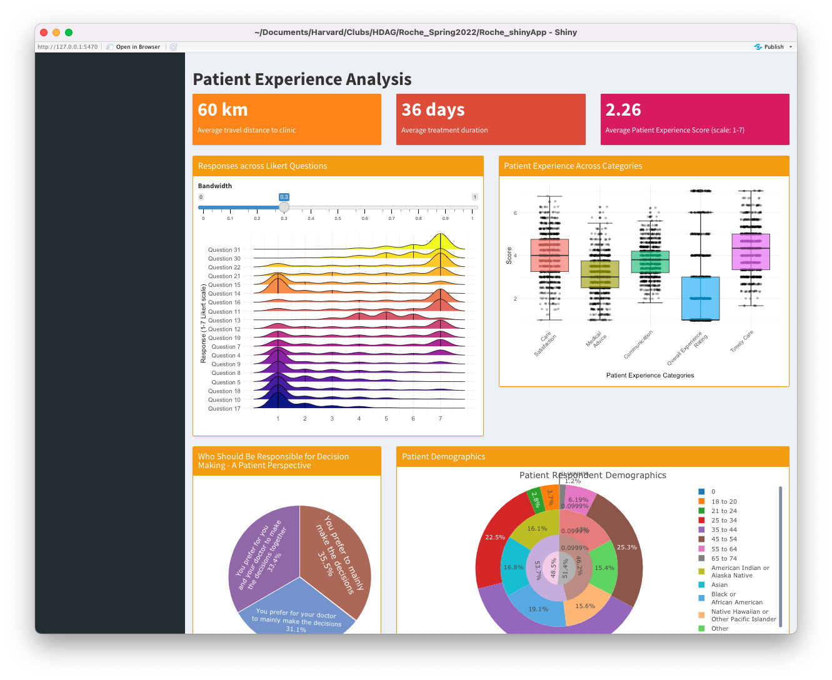
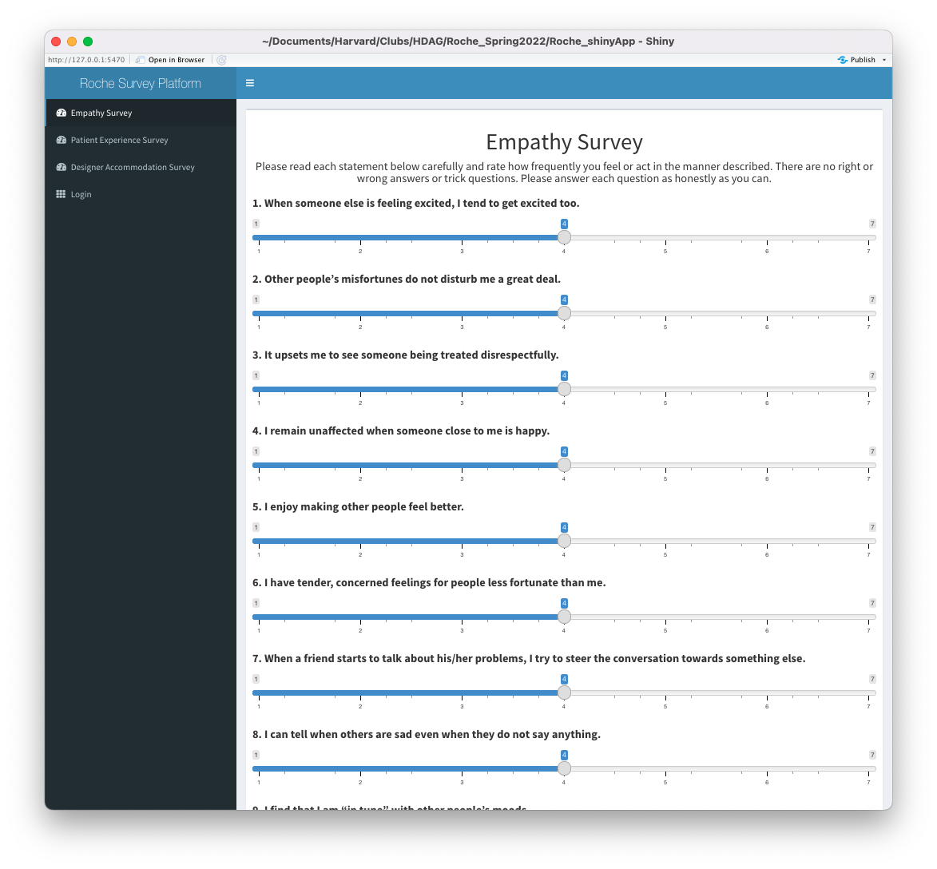
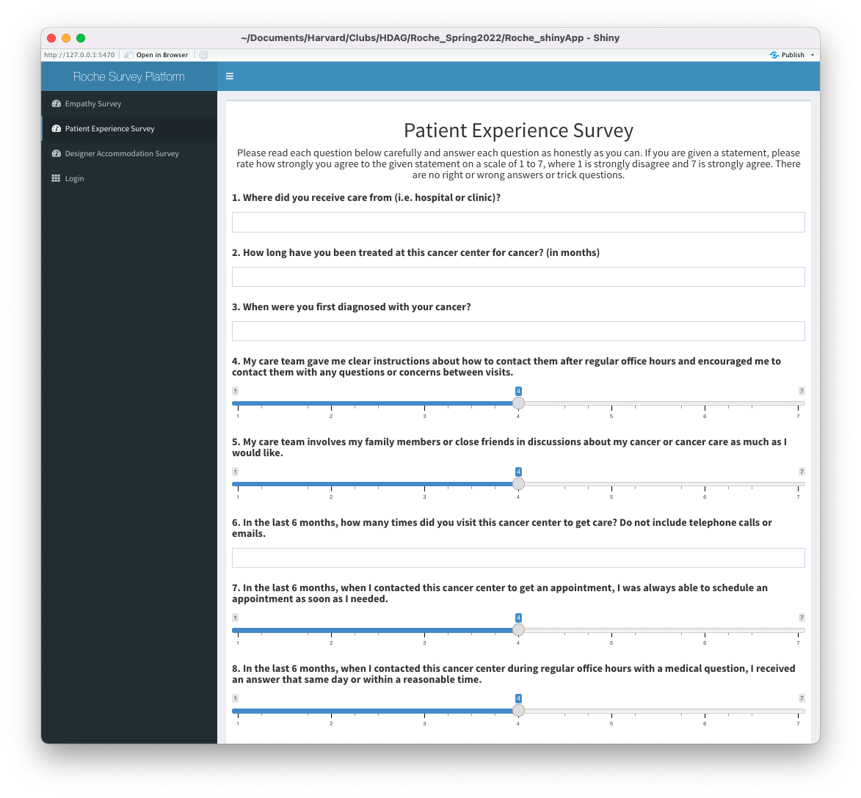
Physical Model: Rshiny app
An Rshiny app was developed as a unified survey and automatic data analytics framework. This allows for streamlined results generation once survey data is collected.
A login page is included to access the data analytics and results summary. Survey-specific insights are automatically generated as more survey responses are recorded.
DEMO

Slide 16
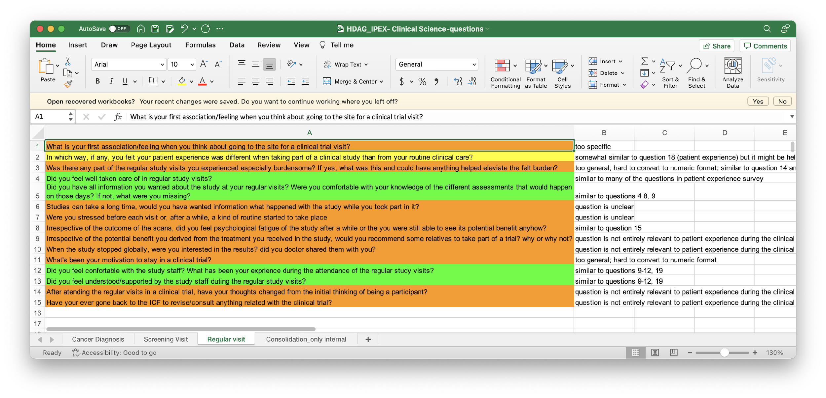
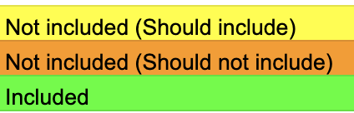
Matching to IPEX Questions
We were recently provided with a list of IPEX Clinical Science questions (list of questions provided by clinical trial scientists). We briefly examined these questions and considered the following:
Are the questions already covered in the current logical model?
If yes, how accurately and which survey questions are they most similar to.
If not, we suggest proper surveys for integration.
Questions that we feel do not fit within the current scope of the surveys are noted as such.
Our notes regarding each of the questions are included in a spreadsheet to be delivered.
Legend:

Slide 17
Final Remarks
Summary...
We conducted a detailed literature review across relevant industries and reported actionable insights and recommendations for next steps. We summarized our findings in a brief synopsis and compiled our paper-by-paper summaries.
We developed a conceptual framework for establishing causal relationships between immersion, study designer empathy, and patient experience, leveraging previously reported study designs and novel ideas generated internally.
Building on our conceptual model, we developed a detailed logical model comprised of a patient experience survey, study designer empathy survey, and study designer accommodation survey. Metrics for quantification were developed.
An Rshiny app was developed for survey collection and automatic data analyses. This allows for streamlined results generation once survey data is collected. Data was strategically simulated for demonstration purposes.
We enjoyed and learned from our collaboration on this project and hope that the work delivered is actionable, interesting, and beneficial to your team!

Slide 18
Discussion & Next Steps

